Slide 1
Group Chat
Alex Gould
Hao Nguyen

Slide 2
task distribution
Chat System – Alex Gould
Login System – Hao Nguyen

Slide 3
AngularJS Chat HTML CSS JavaScript PHP SQL

Slide 4
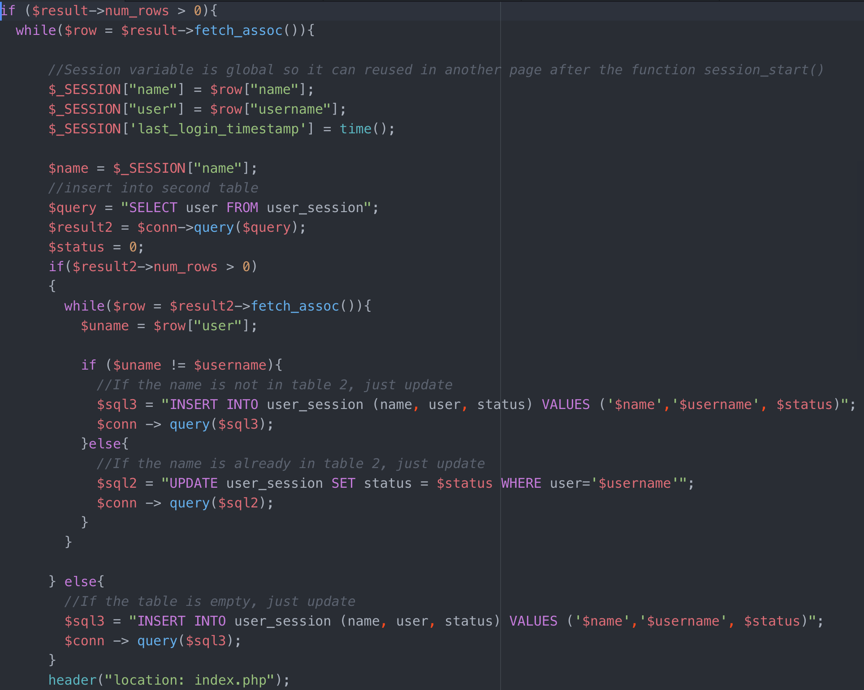
PHP
Update user’s login status
0 = login
1 = logout

Slide 5
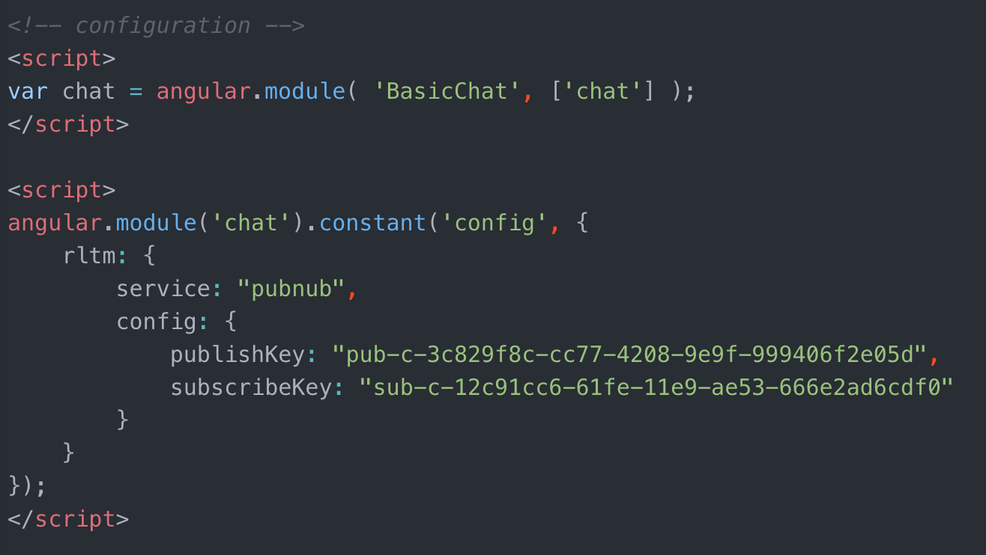
API

Slide 6
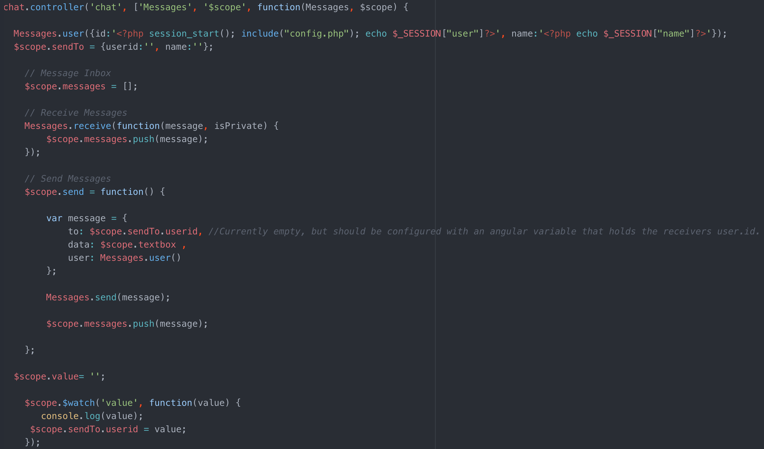
AngularJS

Slide 7
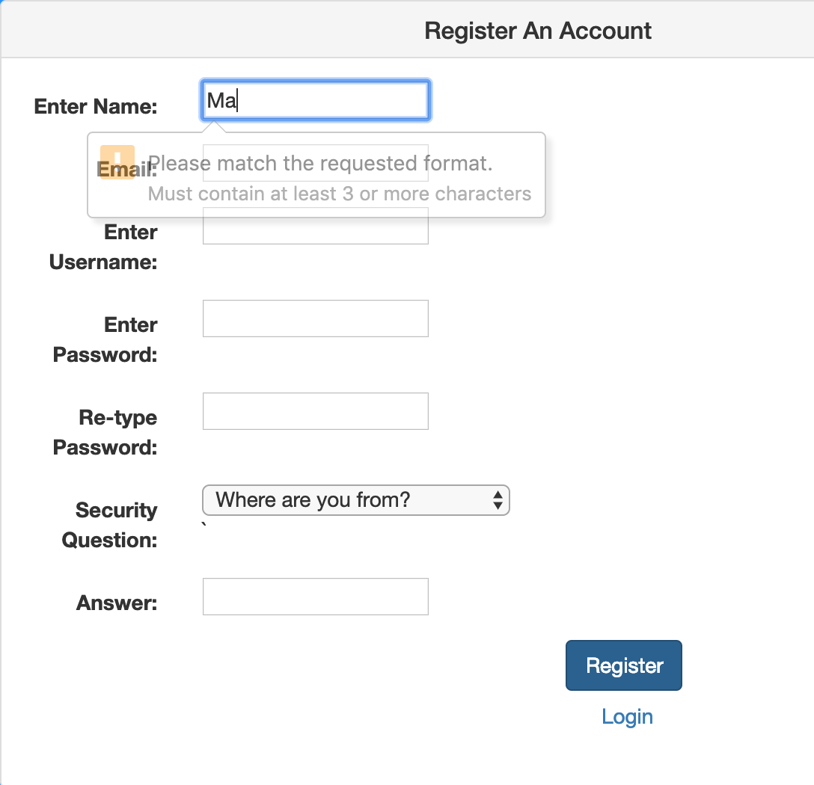
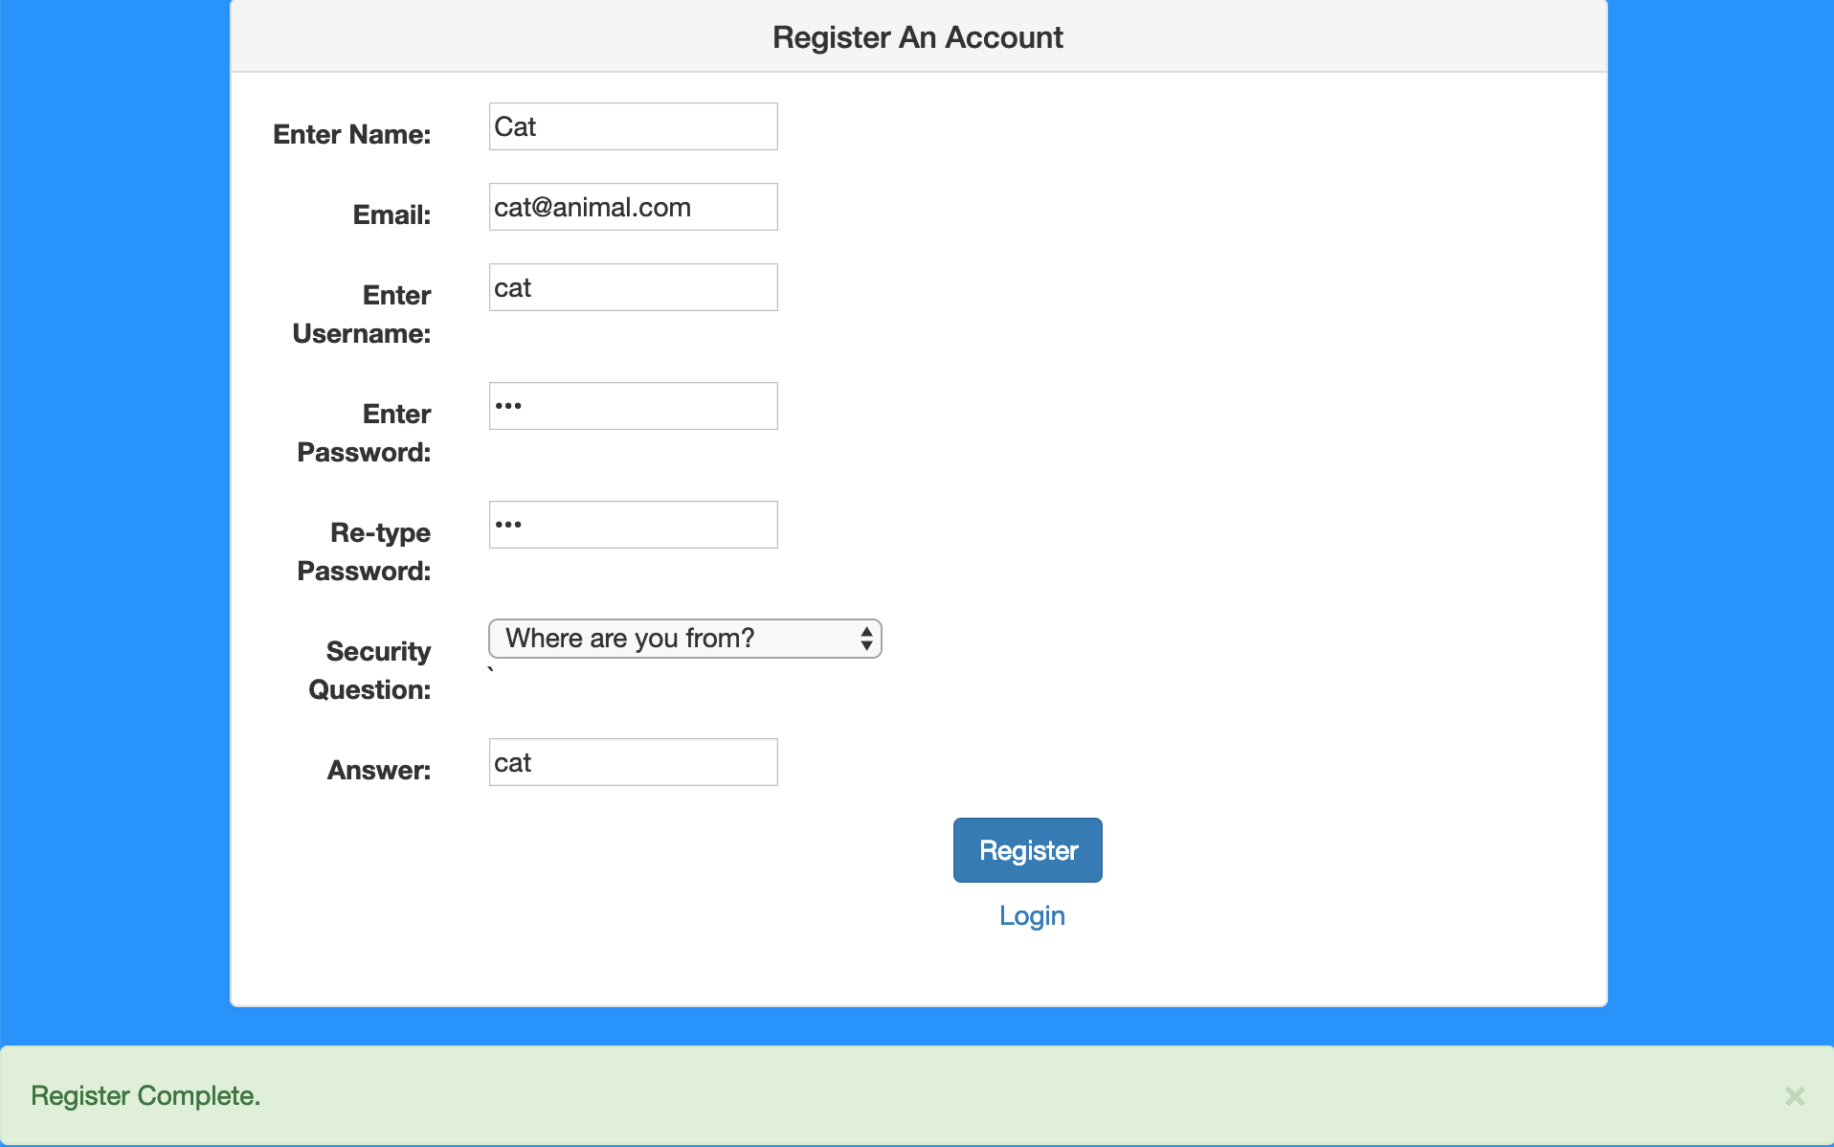
Registration Test

Slide 8
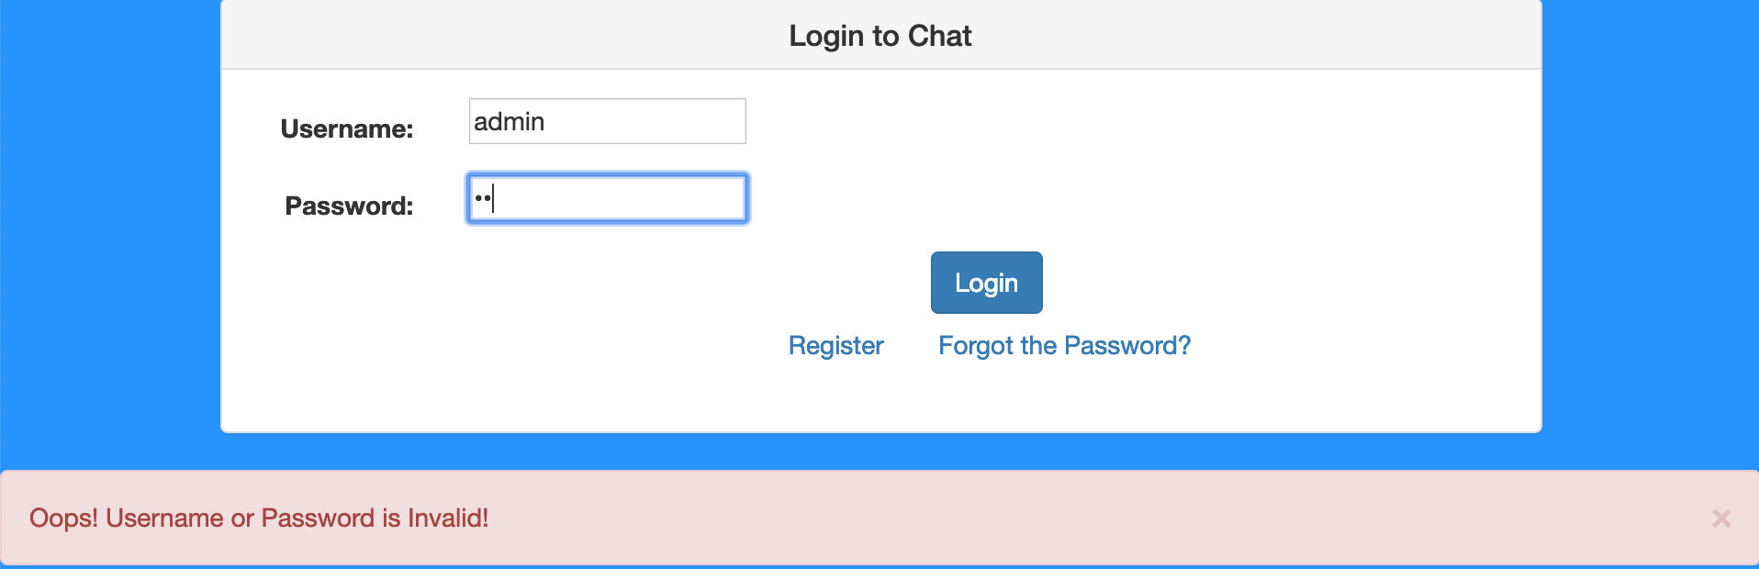
Login Test

Slide 9
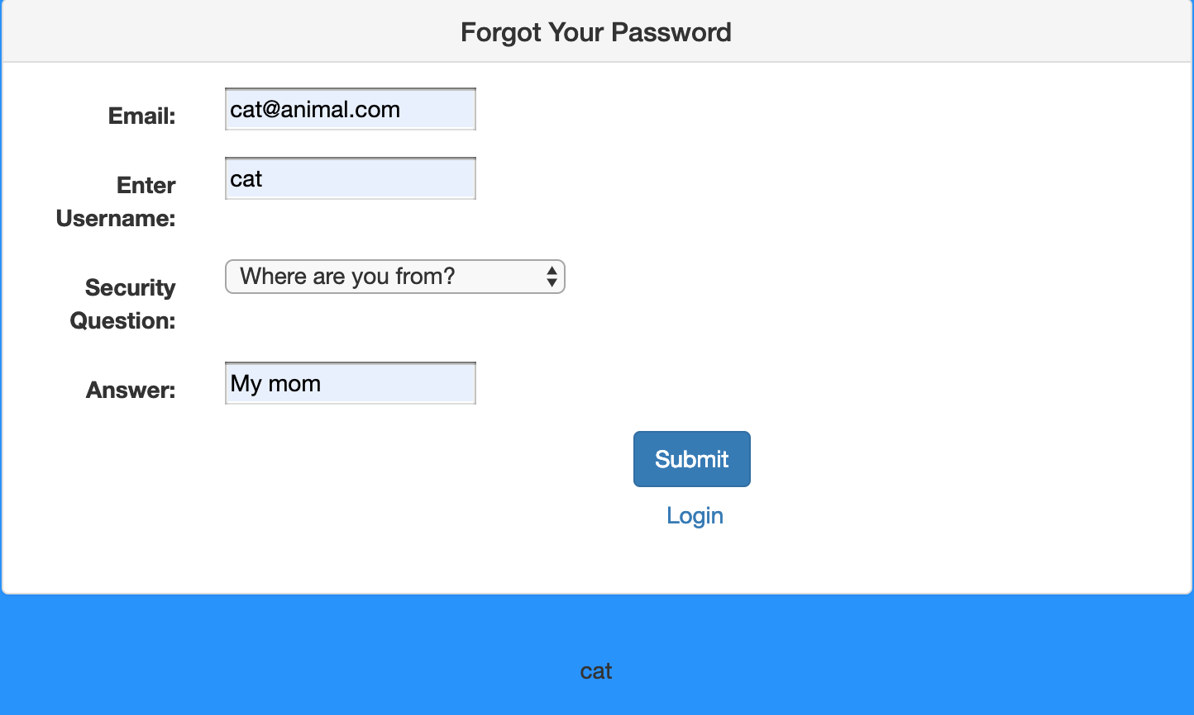
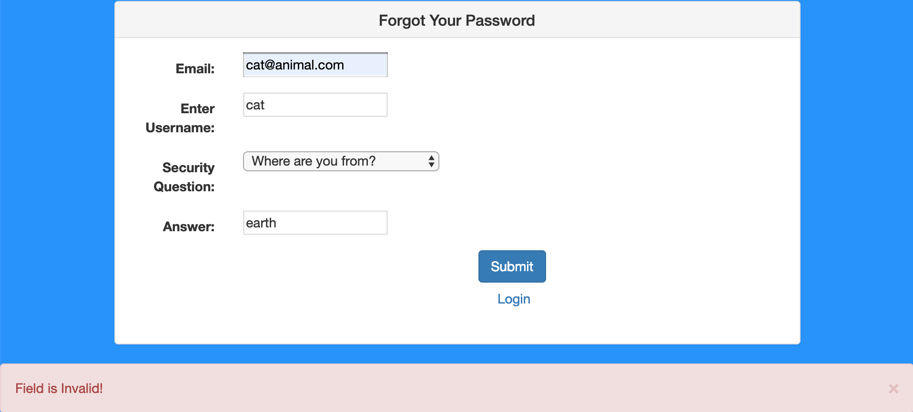
Test Forgot

Slide 10
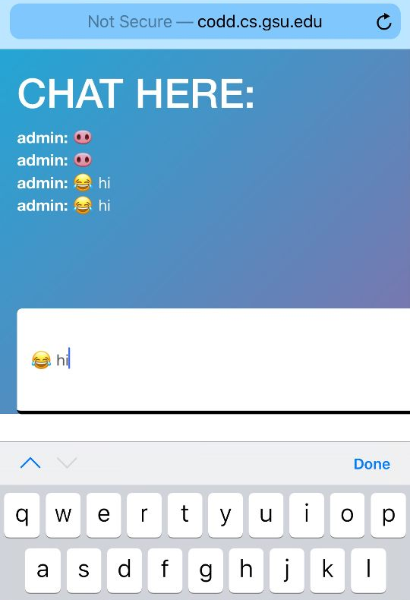
Scale on Phone

Slide 11
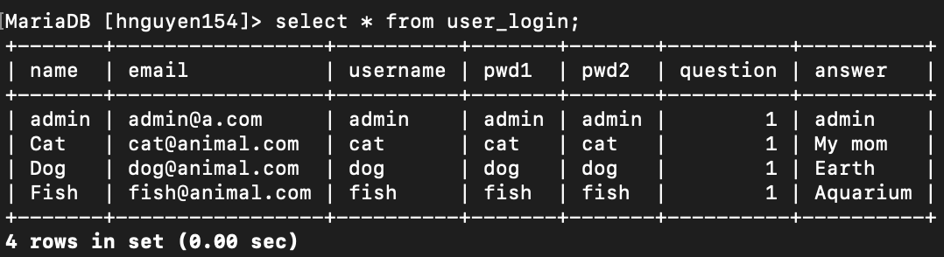
Demo
http://codd.cs.gsu.edu/~hnguyen154/finalproj/login.php
Using Chrome, Firefox, and Internet Explorer

